Slide 1
LATIF JI BOLI
A Sindhi Programming Language Interpreter
Muhammad Muzamil • 22SWE30 • Group Leader
Ali Yawar • 22SW43 • Asst: Group Leader
Ahsan Abbas • 22SW12 • Asst: Group Leader
Supervisor: Dr. Ali Raza Bhangwar
Department of Software Engineering • QUEST Nawabshah • 2026

Slide 2
Outlines
1. Introduction
2. Literature Review & Summary Table
3. Problem Statement
4. Aim and Objectives
5. Methodology
6. Implementation
7. Results
8. Conclusion
9. References
2

Slide 3
Introduction
What is Latif Ji Boli?
Latif Ji Boli is a Sindhi programming language interpreter developed in Java. It allows users to write and execute programs using Sindhi-language keywords and Unicode Sindhi script. The main idea is to provide a programming environment where Sindhi-speaking users can work with programming concepts using their own language.
Purpose
The purpose of Latif Ji Boli is to provide a familiar educational programming environment for Sindhi-speaking learners. It reduces the dependency on English-based programming terminology while keeping the core logic and concepts of modern programming. In this way, learners can focus more on understanding programming concepts instead of struggling with unfamiliar language terminology.
3

Slide 4
Introduction
Main Features
Technology Stack
Latif Ji Boli supports the basic features required for introductory programming, including variables, numeric and string data, arithmetic and logical operations, conditional statements, while and do-while loops, output generation, and syntax and runtime diagnostics. These features allow users to write meaningful programs and execute them using Sindhi syntax.
The system uses Java as the core technology for developing the interpreter, while Spring Boot is used to provide the backend API and connect the programming engine with the web application. Angular is used to develop the web interface through which users can write and execute programs. Unicode is used for processing and supporting Sindhi characters and script throughout the system.
System Flow
Sindhi source code → Lexer → Tokens → Interpreter → Output / Error
3

Slide 5
Literature Review
WHAT IS BEING REVIEWED?
1. Programming Education & Language
Research shows that programming learners who are not native English speakers can face additional barriers when programming resources, terminology and code are English-centered. Guo analyzed 840 responses from 86 countries and reported barriers involving instructional materials, technical communication and reading/writing code. [18]
2. Native Language & Learning
Reestman and Dorn examined Java compiler-error data across native-language groups. Their findings show that language context is a legitimate research issue, while also warning that statistical differences do not automatically imply a large practical effect. [20]
3. Programming-Language Localization
Piech and Abu-El-Haija developed CodeInternational to translate source code between human languages and explored localized programming instruction in 100 spoken languages. [19]
4. Regional-Language Programming
Perera and Ahangama explored Sinhala-based coding through SimplyTrans, showing how programming-language localization can be applied to a regional language. [21]
4

Slide 6
WHAT THE REVIEW TELLS US
Programming-language localization is an established research direction rather than a new idea.
Language accessibility affects how beginners interact with programming concepts and learning materials.
Localization is broader than translating a few keywords; syntax, terminology and language-specific conventions can also matter.
Existing work demonstrates multilingual/localized programming in several contexts, but the literature reviewed for this project does not identify a widely adopted Sindhi programming environment combining Sindhi syntax, Unicode processing, lexical analysis, token management and interpreter execution.

Slide 7
Summary Table: Existing Languages vs Latif Ji Boli
The table summarizes the technical position of Latif Ji Boli against established general-purpose languages.
Feature
C
Python
Java
Latif Ji Boli
Text-based programming
Yes
Yes
Yes
Yes
English keywords
Yes
Yes
Yes
No
Sindhi keywords
No
No
No
Yes
Unicode / text support
Implementation-dependent*
Yes
Yes
Yes
Execution model
Native compilation
Interpreter / VM
Bytecode + JVM/JIT
Custom interpreter
Sindhi syntax
No
No
No
Yes
Educational localization
No
No
No
Primary design focus
Regional-language support
No
No
No
Yes
5

Slide 8
Problem Statement
Most mainstream programming languages use English-based keywords and syntax, so beginners may need to learn programming logic and unfamiliar terminology at the same time.
For Sindhi-speaking learners, this additional language dependency can make introductory programming concepts harder to understand.
Available programming environments provide very limited support for programming directly with Sindhi keywords and Unicode Sindhi syntax.
The identified research gap is a complete Sindhi programming environment combining lexical analysis, token management, interpreter execution, Unicode processing and educational programming features.
English-based syntax
Additional language dependency
Learning barrier
Limited localized tools
2

Slide 9
Aim & Objectives
Aim
Design and develop a functional Sindhi Programming Language Interpreter that enables users to write, analyze and execute programs using Sindhi syntax.
Design a programming language using Sindhi keywords.
Implement a Unicode-compatible lexical analyzer.
Develop an efficient token management system.
Design an interpreter for executing Sindhi programs.
Support variables, expressions, loops and conditions.
Simplify programming education for Sindhi-speaking students.
Promote regional-language computing and provide a foundation for future compiler research.
3

Slide 10
Methodology
Research Design — Design Science Research (DSR)
The project follows the Design Science Research (DSR) methodology, where a technological artifact is designed, implemented, and evaluated to address a specific practical problem. In this project, the artifact is the Latif Ji Boli programming environment, developed to address the limited availability of programming environments that support Sindhi syntax and Unicode Sindhi text.
RESEARCH / DSR STAGES
1
2
3
4
5
Problem
Requirements
System Design
Implementation
Testing
4

Slide 11
Methodology
Software Development — Incremental Model
For software development, the project follows the Incremental Model, where the programming environment is developed through separate functional increments instead of implementing the complete system at once. Each component is developed and tested independently before being integrated with the other components. This approach makes it easier to identify errors, verify individual components, and progressively build the complete interpreter.
INCREMENTAL DEVELOPMENT
1
Lexer
Unicode scanning + tokenization
2
Token Manager
Type/value/location storage
3
Interpreter
Variables + expressions + control flow
4
Integration
Spring Boot + Angular
5
Testing
Unit + integration + execution tests

Slide 12
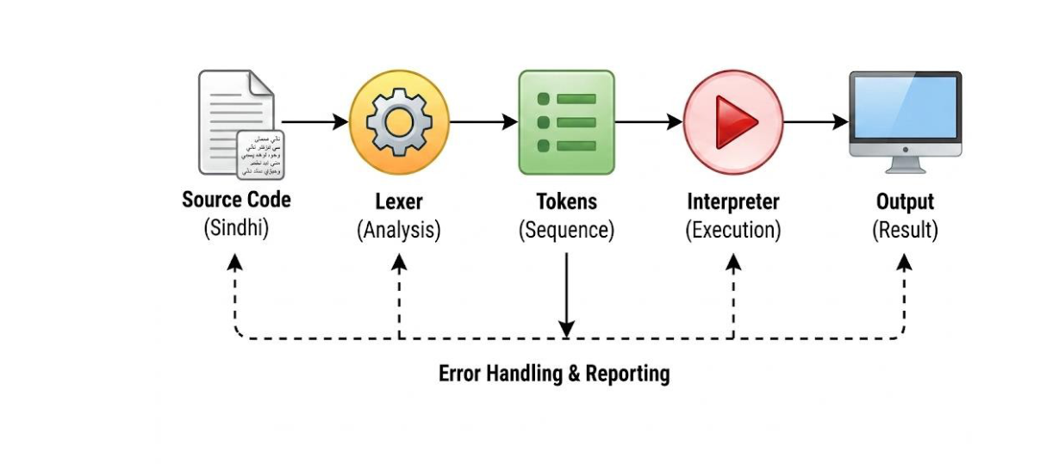
Implementation
Compiler processing pipeline
5

Slide 13
Implementation
1. Lexical Analyzer
The Lexical Analyzer, or Lexer, is the first major component of Latif Ji Boli. Its main responsibility is to read the Sindhi source code character by character and identify meaningful programming elements. It recognizes Sindhi keywords, identifiers, numbers, strings, operators, punctuation, and Unicode Sindhi characters. After identifying these elements, the Lexer converts them into structured tokens that can be processed by the next stage of the interpreter. It also detects invalid or unsupported characters and reports lexical errors with relevant source locations.
2. Token Management
The Token Management component is responsible for organizing and storing the tokens generated by the Lexer. Each token contains important information such as its token type, actual value, line number, and column number. This information allows the interpreter to understand what each part of the source code represents and where it appears in the program. Token management also helps maintain the correct order of tokens so that the interpreter can process the Sindhi program accurately and provide meaningful error locations when an invalid statement is encountered.
5

Slide 14
Implementation
3. Interpreter
The Interpreter is the core execution component of Latif Ji Boli. It receives the tokens generated by the Lexer and Token Management components and processes them according to the rules of the Sindhi programming language. The interpreter manages variables, assignments, arithmetic and logical expressions, conditional statements, loops, and output operations. It maintains program state through a symbol table and evaluates expressions to produce the expected results. It also detects runtime problems such as undeclared variables, invalid expressions, and division by zero.
4. Web Integration
The implemented interpreter is integrated into a web-based programming environment using Spring Boot and Angular. The Angular frontend provides the user interface where users can write Sindhi programs and request their execution. The Spring Boot backend receives the source code through the API and passes it to the Latif Ji Boli interpreter for lexical analysis, token processing, and execution. After processing, the backend returns the generated output or relevant error information to the Angular interface, allowing users to see the result directly in the web application.
5

Slide 15
Results
1. Functional Evaluation
The developed Latif Ji Boli interpreter was functionally evaluated to verify whether the implemented programming features work correctly. The evaluation confirmed successful lexical analysis, token generation, Unicode Sindhi processing, variable management, arithmetic and logical operations, conditional statements, loops, string handling, error detection, and output generation. These results demonstrate that the interpreter is capable of processing and executing the main programming constructs supported by the developed language.
Functional Features Evaluated
Lexical Analysis — Source code is analyzed and converted into tokens.
Token Generation — Programming elements are represented as structured tokens.
Unicode Sindhi Processing — Sindhi characters and script are processed correctly.
Variable Management — Variables can be declared, assigned, and used.
Arithmetic & Logical Operations — Expressions can be evaluated.
Conditional Statements — Conditional program logic is supported.
Loops — Repetitive program execution is supported.
String Handling — String values can be processed.
Output Generation — Program results are generated successfully.
6

Slide 16
Results
2. Supported Programming Features
The developed Latif Ji Boli interpreter successfully supports the core programming constructs required for writing and executing basic Sindhi programs. The implemented system allows users to work with variables, numeric and string data, arithmetic and logical operations, conditional statements, while and do-while loops, and output generation. These features demonstrate that the interpreter can execute fundamental programming logic while using Sindhi keywords and Unicode Sindhi text.
Key Results
Variables — Declaration, assignment, and variable usage.
Numeric & String Data — Supports basic data handling.
Arithmetic Operations — Performs mathematical calculations.
Logical Operations — Supports logical expressions.
Conditional Statements — Executes decision-making logic.
While / Do-While Loops — Supports repetitive execution.
Output Generation — Displays program results.
Sindhi Syntax — Programming can be written using Sindhi keywords.
Unicode Support — Handles Sindhi Unicode characters.
6

Slide 17
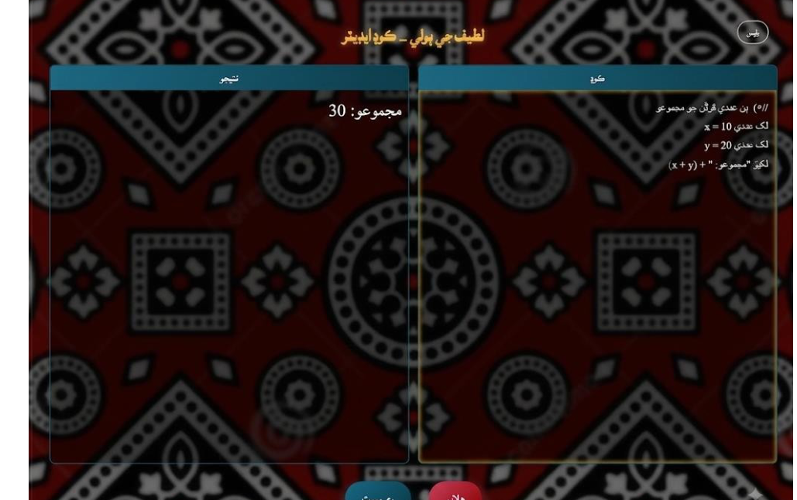
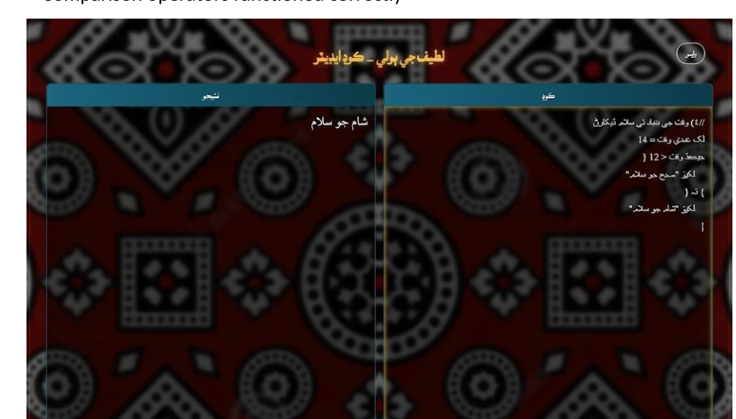
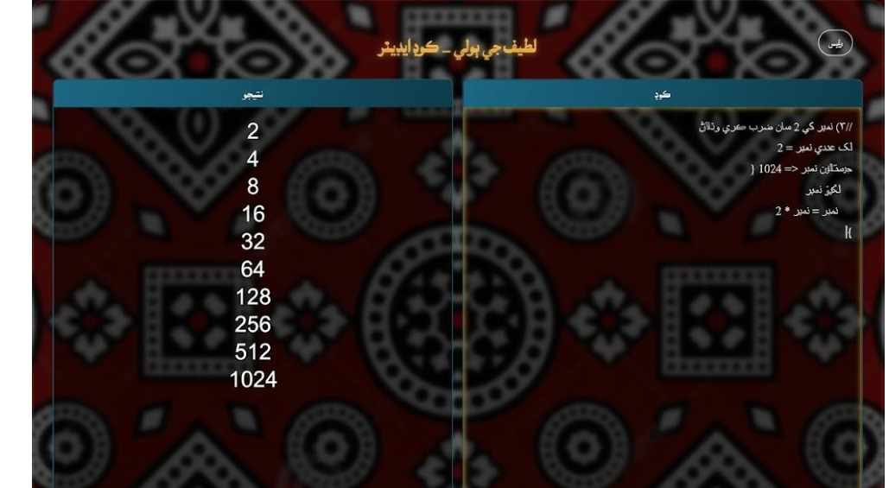
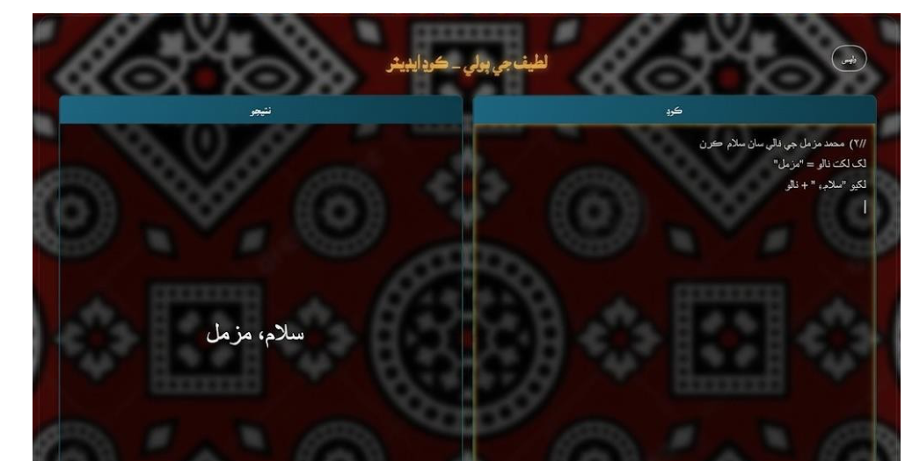
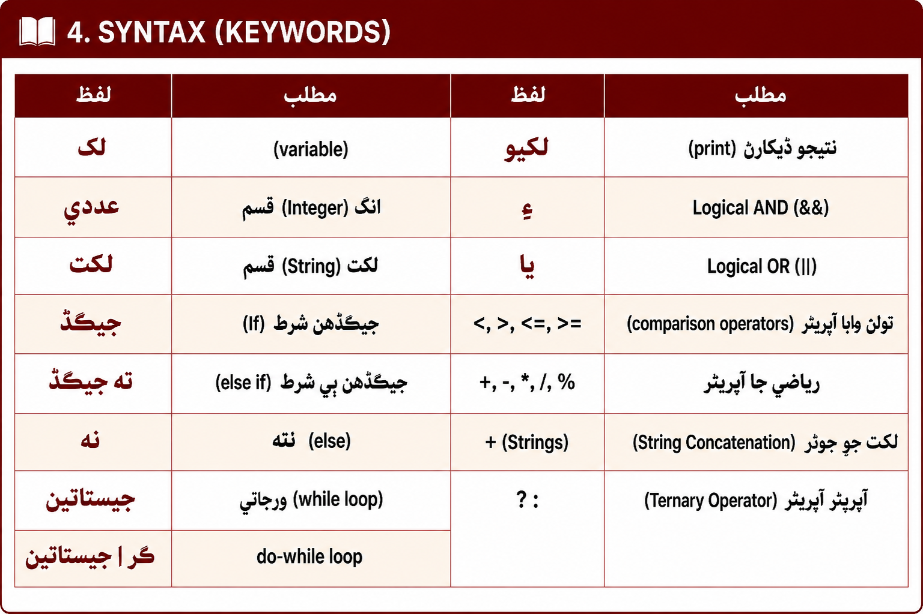
Results
Arithmetic
Conditional
Loops
String Handling
6

Slide 18
Conclusion
1. Overall Achievement
Latif Ji Boli was successfully designed, implemented, and evaluated as a functional Sindhi programming language interpreter. The project provides a programming environment where users can write and execute programs using Sindhi keywords and Unicode Sindhi script. The developed system addresses the language barrier faced by Sindhi-speaking learners by providing programming concepts in a more familiar linguistic context. The project demonstrates that programming-language concepts can be adapted to a regional language while maintaining the fundamental logic and structure of programming.
Key Achievements
Developed a functional Sindhi programming language interpreter.
Enabled programming using Sindhi keywords and Unicode Sindhi script.
Provided support for fundamental programming concepts.
Created a web-based environment for writing and executing Sindhi programs.
Addressed the lack of localized programming support for Sindhi learners.
Established a foundation for further development of Sindhi-language computing tools.
7

Slide 19
Conclusion
2.Technical Achievement
From a technical perspective, Latif Ji Boli integrates the major components required for a programming language interpreter. The system includes a Unicode-compatible lexical analyzer for processing Sindhi source code, a token management system for organizing generated tokens, and an interpreter for executing programming constructs such as variables, expressions, conditions, loops, and output. These components are integrated with a Spring Boot backend and Angular web interface, providing a complete environment for writing and executing Sindhi programs.
Key Technical Achievements
Lexical Analysis — Unicode-compatible Sindhi source-code processing.
Token Management — Structured handling of token type, value, and location.
Interpreter — Execution of variables, expressions, conditions, loops, and output.
Unicode Processing — Support for Sindhi characters and script.
Spring Boot Integration — Backend API for communication with the interpreter.
Angular Integration — Web interface for writing and executing programs.
End-to-End Execution — Source code can move through the complete processing pipeline to generate output.
7

Slide 20
References
[1] Aho, Lam, Sethi & Ullman, Compilers: Principles, Techniques, and Tools, 2nd ed., 2006.
[2] Cooper & Torczon, Engineering a Compiler, 3rd ed., 2022.
[4] The Unicode Consortium, The Unicode Standard, Version 17.0.0, 2025.
[5] Hevner et al., Design Science in Information Systems Research, 2004.
[6] Peffers et al., Design Science Research Process, 2007.
[9] Sommerville, Software Engineering, 10th ed., 2016.
[12] Oracle, The Java Language Specification, Java SE 26 Edition, 2026.
[13] Oracle, Java SE 26 Documentation, 2026.
[14] VMware, Spring Boot Reference Documentation.
[15] Google, Angular Documentation.
[18] Guo, Non-Native English Speakers Learning Computer Programming, CHI, 2018.
[19] Piech & Abu-El-Haija, Human Languages in Source Code, 2020.
[20] C. Reestman and B. Dorn, “Native Language’s Effect on Java Compiler Errors,”
[21] P. Perera and S. Ahangama, “SimplyTrans: A Simplified Approach to Sinhala-Based Coding and Introductory Programming Language Localization,”
8

Slide 21
Thanks
Any Question?

